Slide 1
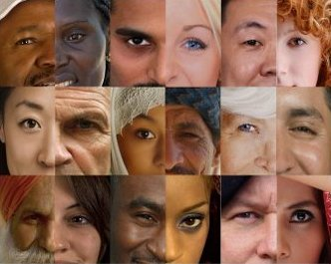
كيف نتعامل مع العلمانية
2 تيموثاوس 3
د. ريك جريفيث• مركز الدراسات اللاهوتية الأردني• BibleStudyDownloads.org

Slide 2
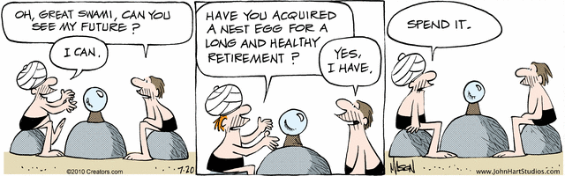
المستقبل
يا سوامي العظيم ، هل تستطيع أن تخبرني عن مستقبلي ؟
هل حصلت على مبلغ من أجل تقاعد طويل وصحي ؟
أصرفه
Nephew
أستطيع
نعم،
عندي
Notes:
A man in the cartoon strip "B.C." seeks crystal ball advice [read].
"B.C" gives a negative view of the future!

Slide 3

كمسيحي، هل يجب أن تكون متفائلاً بخصوص المستقبل ؟

Slide 4
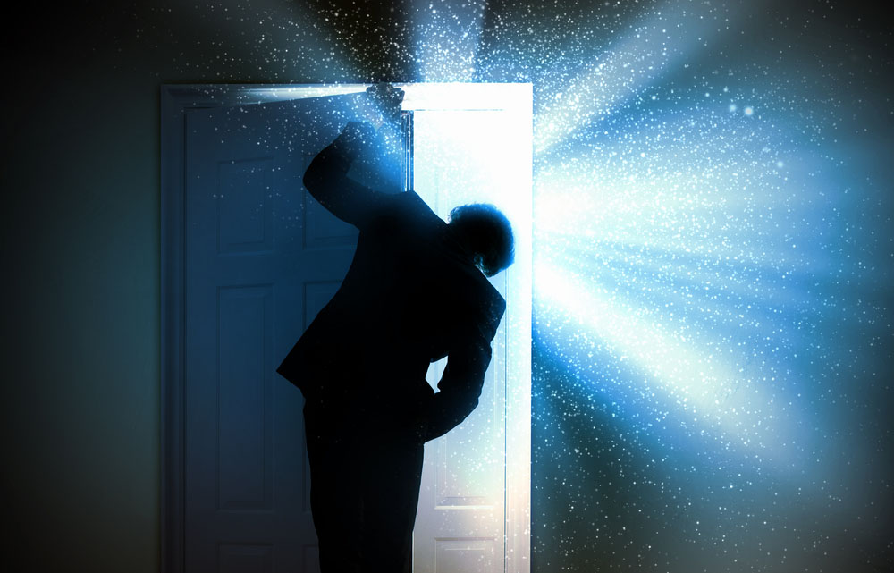
المستقبل
Notes:
One could say that Christians ought to be the most positive people on the planet

Slide 5

المستقبل
Notes:
After all, who else has the assurance of sins forgiven and a heavenly home? Who else has a Guide right now who knows everything, loves us unconditionally, and can do anything? Doesn't it seem that believers ought to be the most confident people about the future?

Slide 6

المستقبل ملك لنا
Notes:
What about you? Are you an optimist? Shouldn't you be?

Slide 7
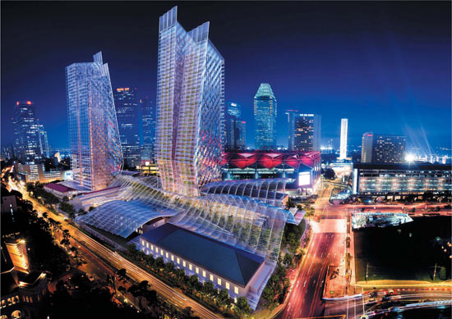
سنغافورة في المستقبل
Notes:
Singapore is now in its 50th year, having grown from a sleepy fishing village to a major player on the global scene.

Slide 8

سنغافورة في المستقبل
Notes:
The economy is looking up—employment is full, property prices are stable or rising.

Slide 9

مزارع سنغافورة العائمة
Notes:
Singapore marches forward toward floating farms…

Slide 10

مزارع سنغافورة العائمة
Notes:
…just outside Marina Bay.

Slide 11

ألا يجب أن نكون متشجعين ؟
Notes:
Even looking at eternal things, the percentage of Christians in Singapore continues to rise, as does the number of churches—growing even faster than the general population increase. Shouldn't Christians be encouraged?

Slide 12

لا يجب أن تتفاءل
كمسيحي ، هل لديك تفاؤل بخصوص المستقبل ؟

Slide 13
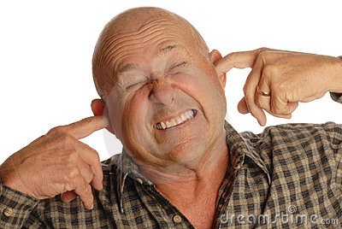
ستصبح الأمور أسوأ
Notes:
The Bible says that the worst days are ahead prior to Christ's return. It is going to get worse. In fact, it started getting worse in the first century. How's that?

Slide 14
نظرة عامة على العهد الجديد (رسائل بولس)
38
124
39-41
إلى أقصى الأرض (أع 1: 8)
أع 9 13 14 15 16 18 21 27 28
نيسان 48-
أيلول 49
1
غلاطية
نيسان 50-
أيلول 52
2
بحر إيجة
ربيع 53-
ايار 57
3
أسيا
شباط 60 –
آذار 62
1
روما
ربيع 62 -
خريف 67
4
إسبانيا
خريف 67 –
ربيع 68
2
روما
أيار 57
آب 59
المحاكمات
صيف 35-37
دمشق
أنطاكية
خريف 49
المجمع
ربيع 68
توسع
الكنيسة
35 48 49 50 52 53 57 60 62 67 68 95
مت
لو
أع
مر
يو
غل
1 تس
1 كو
أف
1 تي
2 تي
2 تس
2 كو
كو
تي
الإرسالية
رو
في
الرعوية
فيل
الأناجيل و الأعمال
1 2 3 4
الرحلات
السجن
الرسائل البولسية
روما
السجون
Pauline Categories
Notes:
_________
NS-00-NT Introduction-96
NS-03-Luke1-12-slide 65

Slide 15
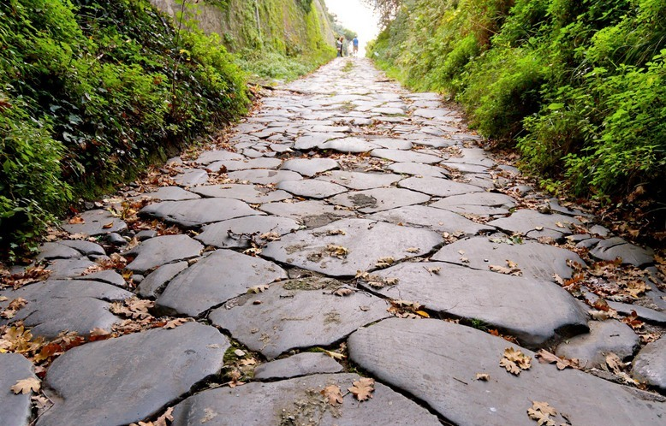
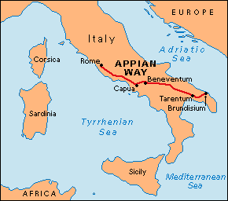
سجن روما الأول (60-62 م، أعمال الرسل 28: 15)
15 ومن هناك لما سمع الإخوة بخبرنا خرجوا لاستقبالنا إلى فورن أبيوس والثلاثة الحوانيت، فلما رآهم بولس شكر الله وتشجع.
Notes:
Paul was warmly welcomed by the believers in AD 60 when he first came to Rome…

Slide 16
المقارنة بين مرات سجن بولس في روما
38
124
39-41
شباط 60-
آذار 62
1
روما
ربيع 62-خريف 67
4
إسبانيا
خريف 67-
ربيع 68
2
روما
60 62 67 68
أف
2 تي
كو
فيل
في
الرسائل البولسية
1 2 3 4
الرحلات
روما
السجون
Notes:
What had changed between Pauls’ two imprisonments in Rome? Much! One key event was the Great Fire at Rome in July AD 64.

Slide 17
المقارنة بين مرات سجن بولس في روما
38
124
39-41
شباط 60-
آذار 62
1
روما
ربيع 62-
خريف 67
4
إسبانيا
خريف 67-
ربيع 68
2
روما
60 62 67 68
صحة نيرون العقلية
متزنة
مجنون
حريق روما 64 م
قبل
بعد
النظرة للمسيحيين
فرقة يهودية
أغلبية من الأمم
تسامح روما
محمية
لا قيود
اضطهاد روما
نادر
منتشر
النتيجة بالنسبة لشاول
أطلق سراحه
قطع رأسه
Notes:
You can see that all legal protections for Christians were removed by the time Paul returned to Rome’s prison system a second time.

Slide 18
السجن الثاني في روما (67-68 م)
أنت تعلم هذا أن جميع الذين في أسيا ارتدوا عني الذين منهم فيجلس و هرموجانس
(2 تي 1: 15)
و جميع الذين يريدون أن يعيشوا بالتقوى في المسيح يسوع يضطهدون و لكن الناس الأشرار المزورين سيتقدمون إلى أردأ مضِلين و مضَلين
(2 تي 3: 12-13)
Notes:
Seven years later the first imprisonment under house arrest, the situation was entirely different. Nero had initiated a persecution of believers and it was very unpopular to be a Christian. May had denied the faith and most had gone underground to the catacombs if they still continued in the faith.

Slide 19

خريف 67 ب. م ( السجن الروماني الثاني )
٢ تيموثاوس ٤ : ٦-٧
٦ فَإِنِّي أَنَا الآنَ أُسْكَبُ سَكِيباً، وَوَقْتُ انْحِلاَلِي قَدْ حَضَرَ. ٧ قَدْ جَاهَدْتُ الْجِهَادَ الْحَسَنَ، أَكْمَلْتُ السَّعْيَ، حَفِظْتُ الإِيمَانَ

Slide 20
أصدقاء بولس خلال السجن الثاني في روما (67-68 م)
^{9يا} تيموثاوس بَادِرْ أَنْ تَجِيءَ إِلَيَّ سَرِيعًا، ¹⁰لأَنَّ دِيمَاسَ قَدْ تَرَكَنِي إِذْ أَحَبَّ الْعَالَمَ الْحَاضِرَ وَذَهَبَ إِلَى تَسَالُونِيكِي، وَكِرِيسْكِيسَ إِلَى غَلاَطِيَّةَ، وَتِيطُسَ إِلَى دَلْمَاطِيَّةَ.
¹¹لُوقَا وَحْدَهُ معي خُذْ مَرْقُسَ وَأَحْضِرْهُ مَعَكَ لأَنَّهُ نَافِعٌ لِي لِلْخِدْمَةِ. ¹²أَمَّا تِيخِيكُسُ فَقَدْ أَرْسَلْتُهُ إِلَى أَفَسُسَ. ¹³اَلرِّدَاءَ الَّذِي تَرَكْتُهُ فِي تَرُواسَ عِنْدَ كَارْبُسَ، أَحْضِرْهُ مَتَى جِئْتَ، وَالْكُتُبَ أَيْضًا وَلاَ سِيَّمَا الرُّقُوقَ. ¹⁴إِسْكَنْدَرُ النَّحَّاسُ أَظْهَرَ لِي شُرُورًا كَثِيرَةً. لِيُجَازِهِ الرَّبُّ حَسَبَ أَعْمَالِهِ. ¹⁵فَاحْتَفِظْ مِنْهُ أَنْتَ أَيْضًا، لأَنَّهُ قَاوَمَ أَقْوَالَنَا جِدًّا.
(2 تي 4: 9-15)
Notes:
Life was lonely for a very relational man like Paul at this point. Most of his friends had either escaped Rome or fallen away from the Faith.

Slide 21
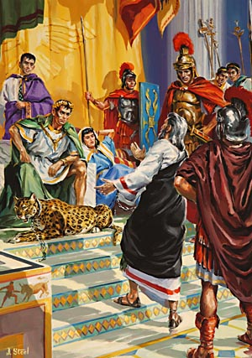
Paul's Second Imprisonment (AD 67-68)
في احتجاجي الأول لم يحضر أحد معي بل الجميع تركوني لا يحسب عليهم و لكن الرب وقف معي وقواني لكي تتم بي الكرازة و يسمع جميع الأمم فأنقذت من فم الأسد
(2 تي 4 : 16-17)
Notes:
Serving Jesus includes times when we feel like no one else is with us in terms of their presence and prayers. But Jesus remains, despite the failures of people.

Slide 22
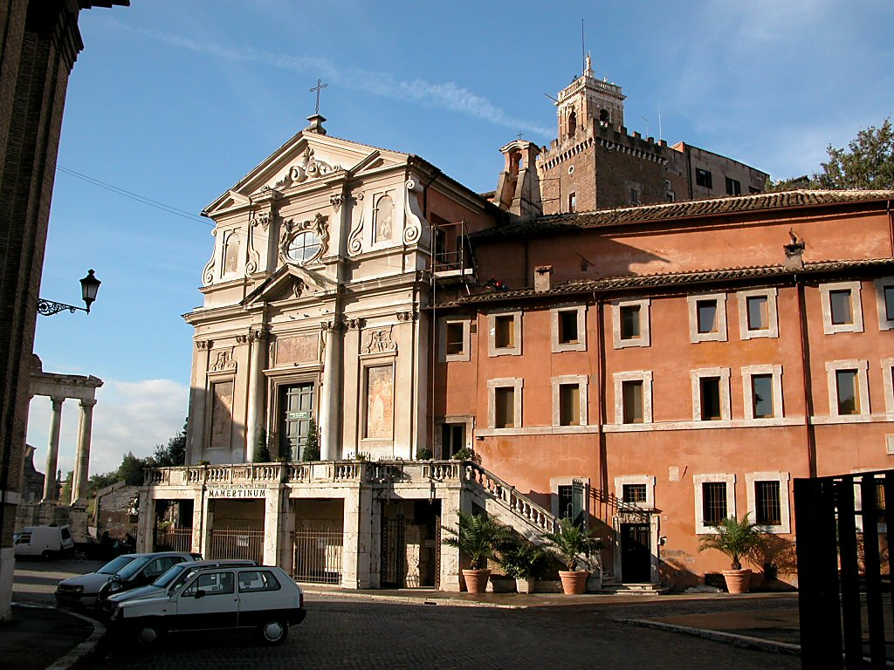
سجن مامرتين
Notes:
The traditional site of the Apostle Paul's and the Apostle Peter's imprisonment in Rome, this prison was simply known as "Carcer" ("prison") in Paul's day. "Mamertine" was attributed to the prison in the Medieval Period. —Todd Bolen, BiblePlaces.com

Slide 23
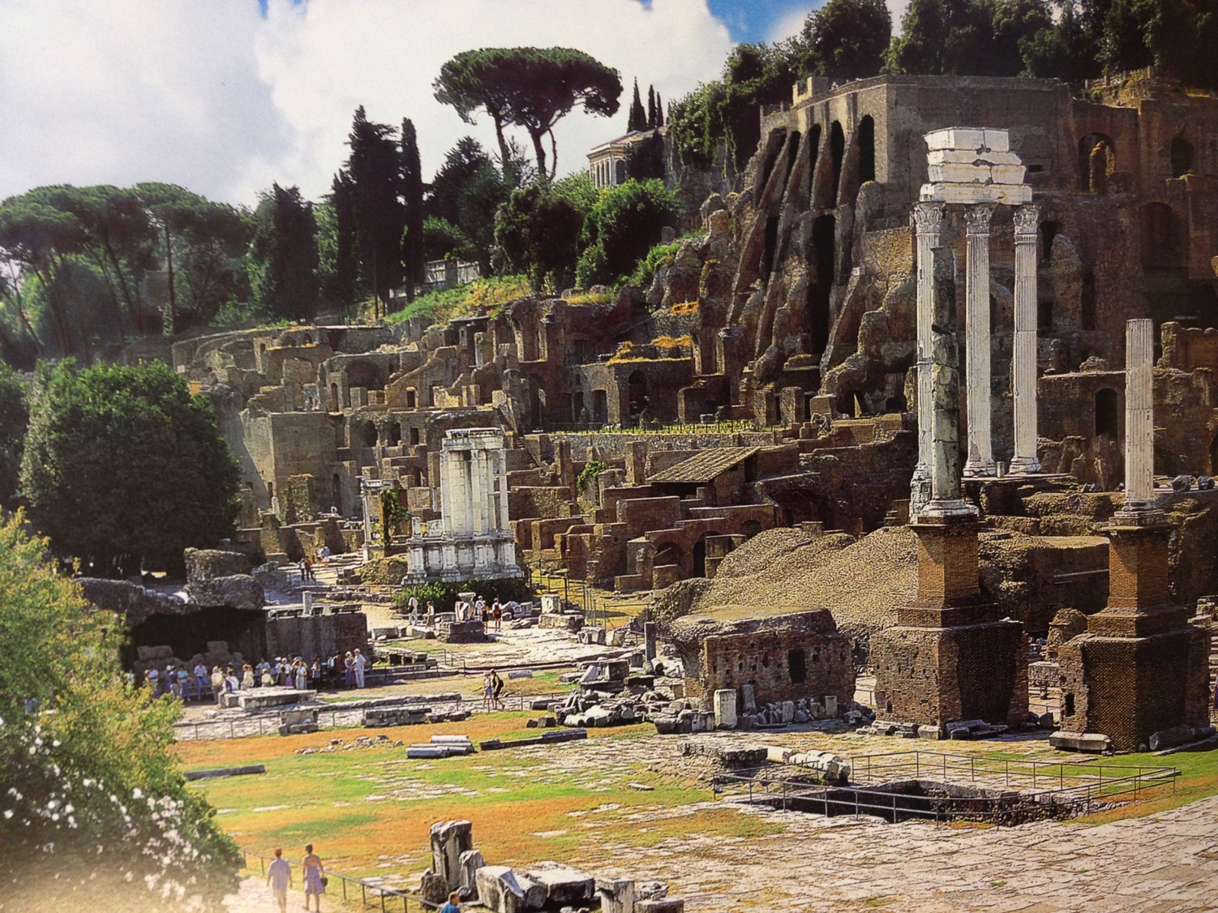
منتدى روما المركزي (الآثار الحديثة)
Notes:
Right across the street from the prison was the most famous location in all the Roman Empire—the Forum, or the seat of power for the Republic.

Slide 24
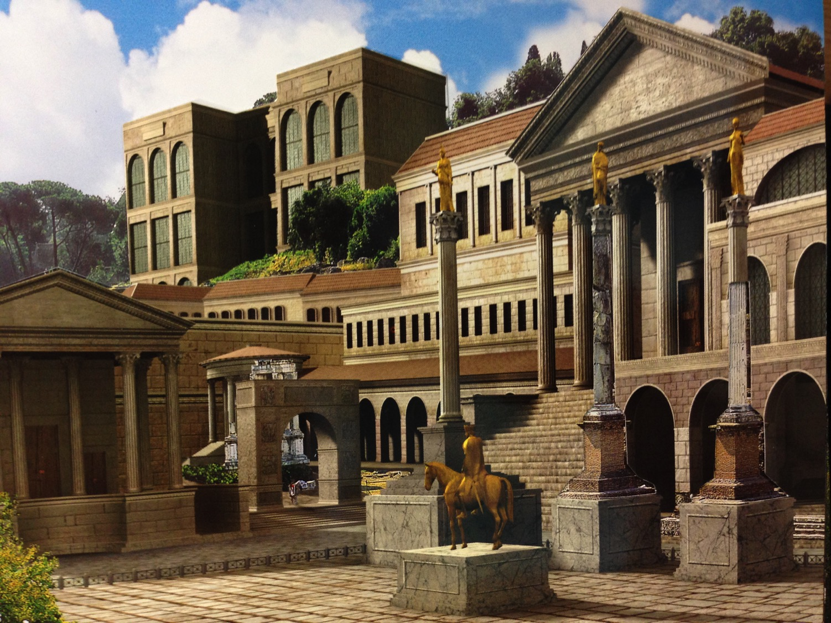
منتدى روما المركزي (القرن الرابع الميلادي)
Notes:
In Paul’s day, the Forum was spectacular. It continued to grow in magnificence until the fourth century AD, when Rome was destroyed.

Slide 25
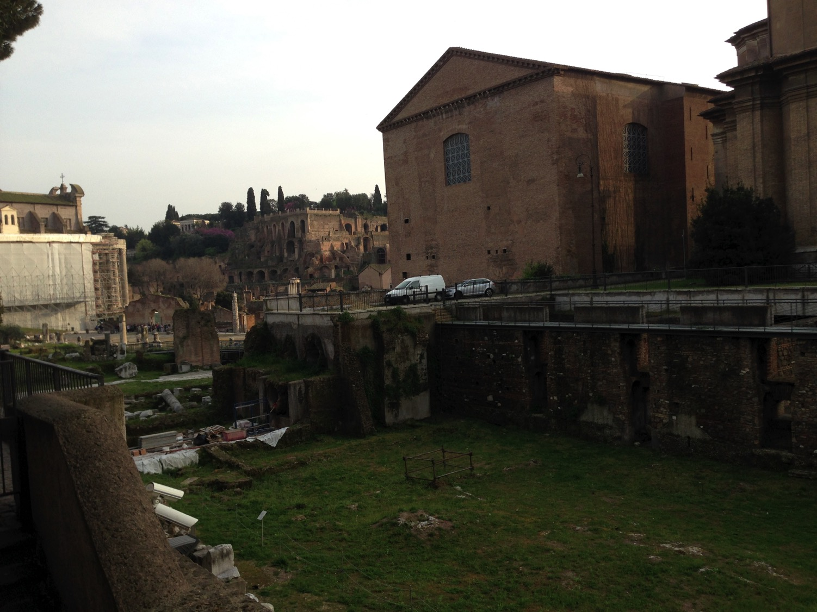
سجن مامرتين
كوريا
مجلس الشيوخ
Notes:
I wonder if Paul knew that Caesar was just across the street!

Slide 26
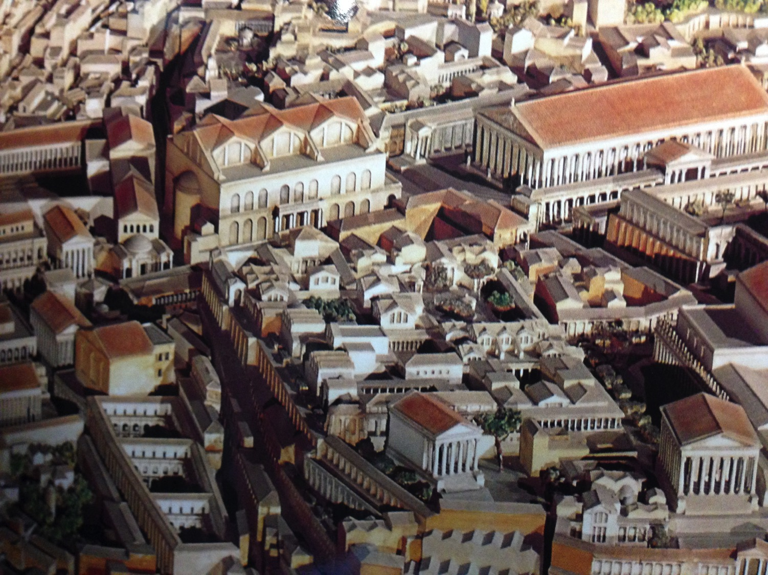
المنتدى المركزي من الأعلى
Notes:
Buildings then were tightly compacted together as they did not need large expressways for vehicles.

Slide 27
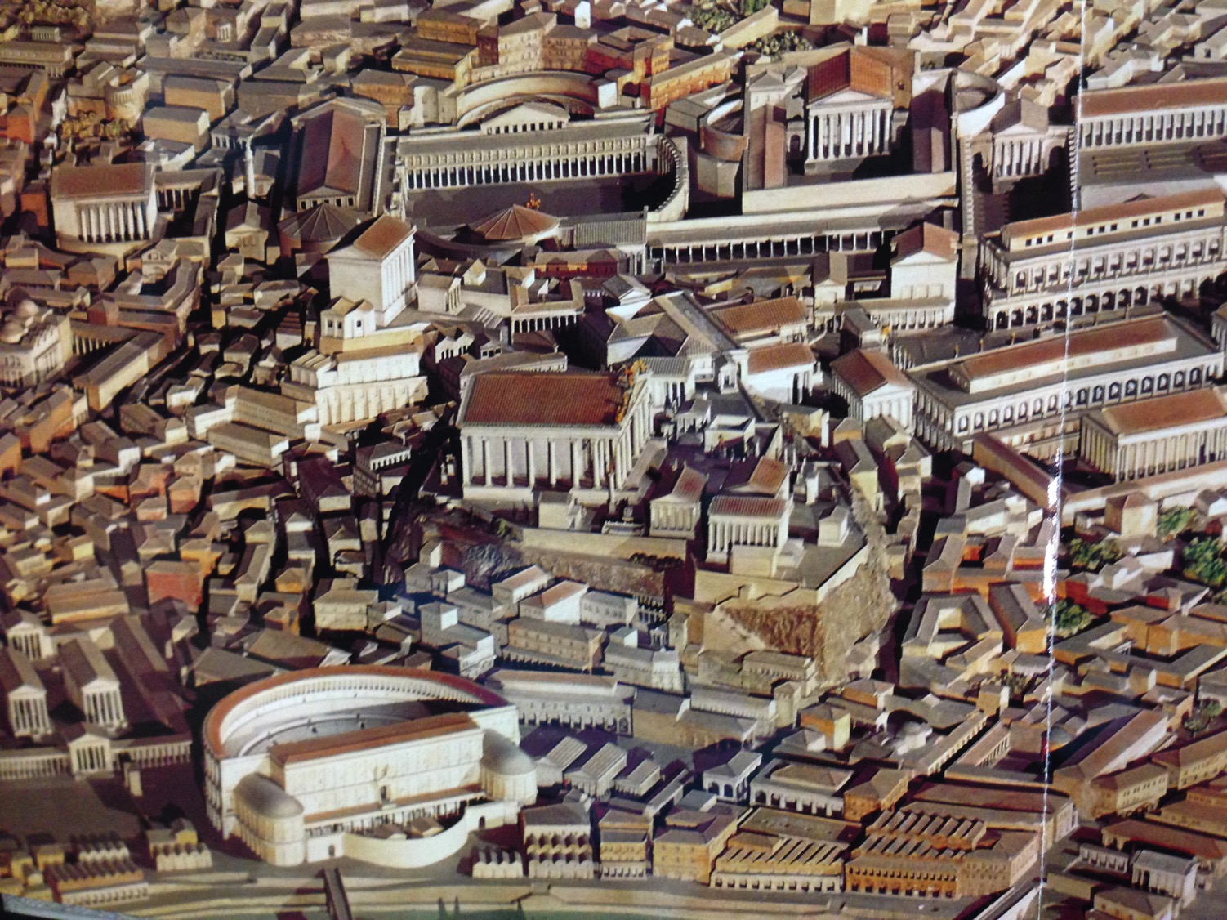
المنتدى الغربي من الأعلى
Notes:
Such buildings included theatres and municipal structures.

Slide 28
مواقع
قريبة
سجن مامرتين
كوريا
مجلس الشيوخ
Notes:
I wonder if Paul knew that Caesar was just across the street!

Slide 29
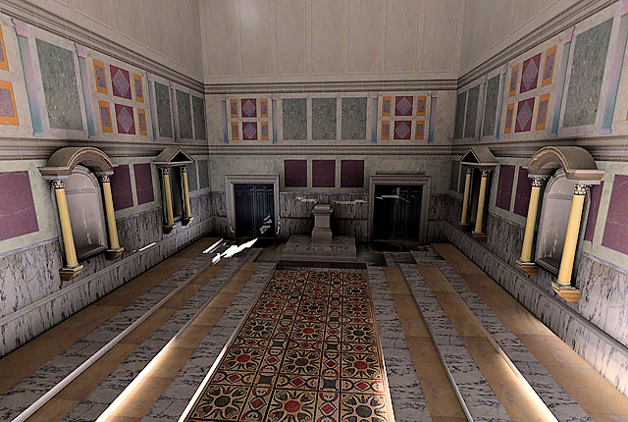
كوريا من الداخل
إعادة بناء الجزء الداخلي من كوريا جوليا، الذي أنشأه مركز التقنيات التجريبية بجامعة كاليفورنيا
Notes:
You can visit the Curia now where aristocratic senators sat in chairs on either side. Toa large extent, their influence had waned by Pauls’ time, as the days of the Republic had given way to the whims of the Emperor, whose power was unchecked.
http://www.vroma.org/~bmcmanus/curiainterior.html

Slide 30
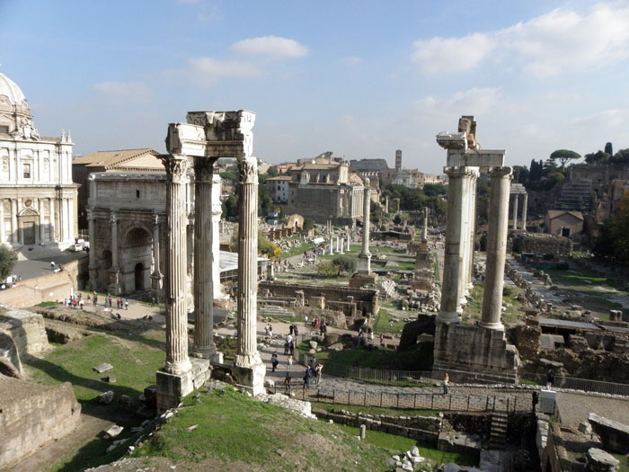
منظر للمنتدى من سجن مامرتين (2014 م)
Notes:
The Forum is in ruins today, but the ideas born here have overtaken the world in the past century, where we have seen that rise of republics like the United States, Singapore, and Taiwan. Similar to this would be the largest democracy in the world, India.

Slide 31
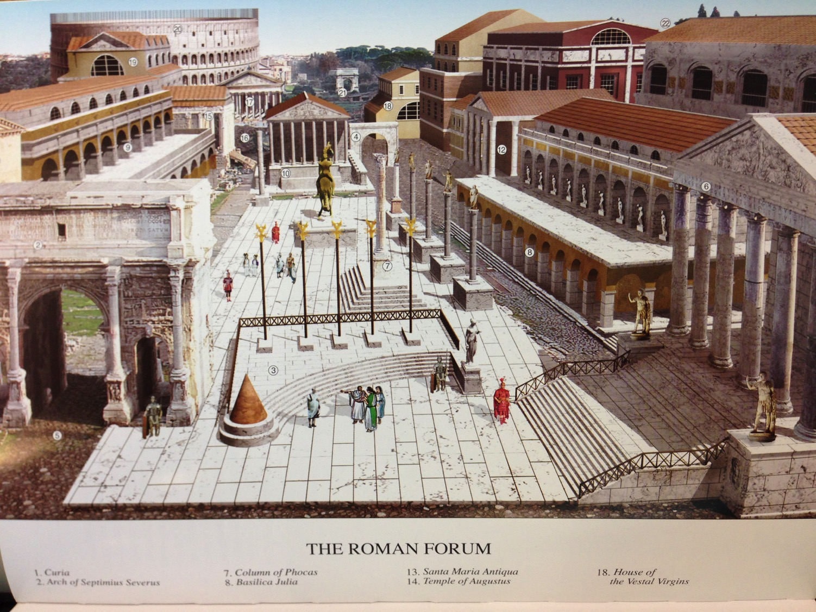
منظر للمنتدى من سجن مامرتين
(القرن الرابع الميلادي)
Notes:
The Forum was filled with buildings and monuments honoring the emperors and generals who expanded the Empire. In AD 80, the Coliseum was completed and can be seen in the rear left. It was funded by the gold seized from burning Herod’s temple in Jerusalem.

Slide 32
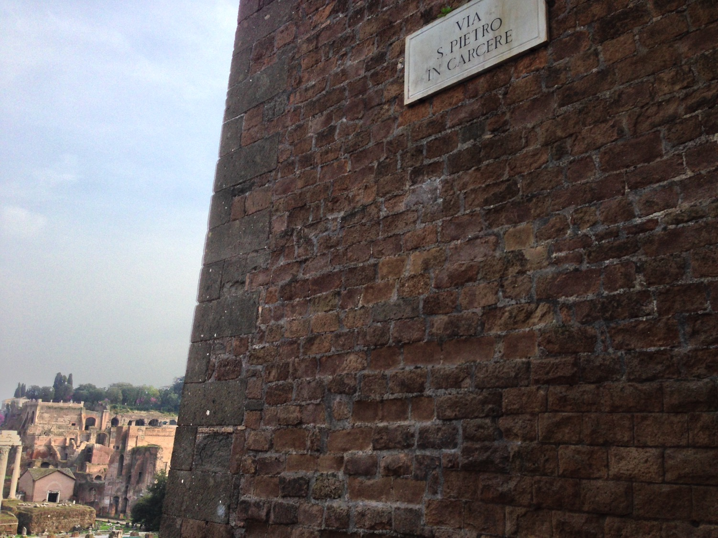
بطرس في شارع السجن
Notes:
Honestly, Susan and I had a very difficult time finding the prison where Paul was held. It wasn’t on any of the tourist maps! Yet, finally, we found it on “Peter in Prison Street”!

Slide 33
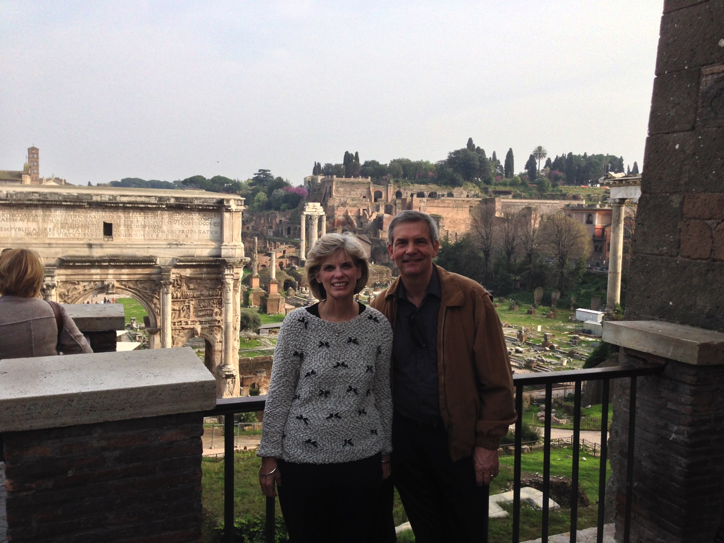
سوزان و ريك أحرار بسبب
سجن بطرس و بولس
Notes:
The thought struck me that I could be free to visit the place 2000 years after Paul lost his freedom on this street. He even lost his life.

Slide 34
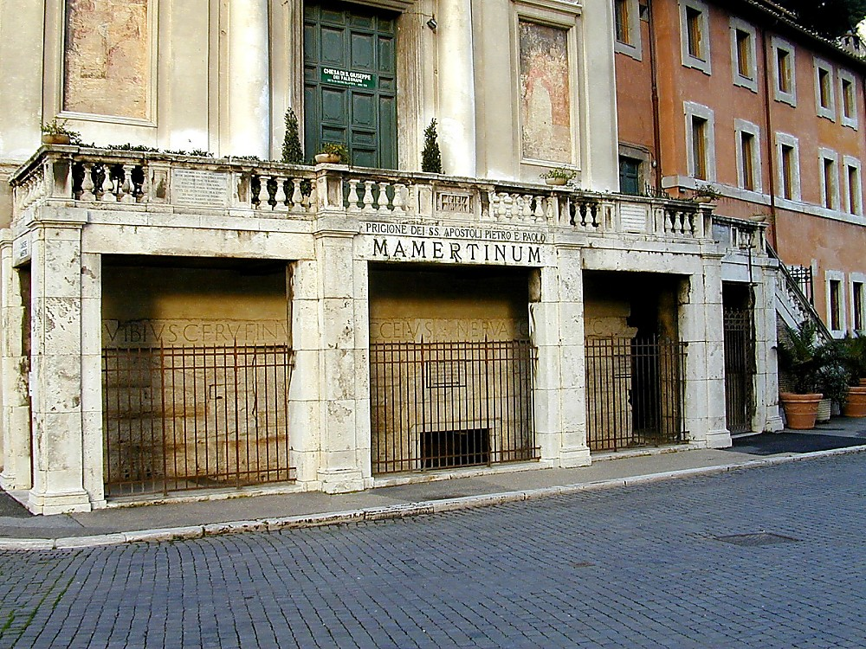
سجن الرسل بطرس و بولس في مامرتين
Notes:
Tourists can visit the prison for a small sum—if you can find it!
—Todd Bolen, BiblePlaces.com

Slide 35
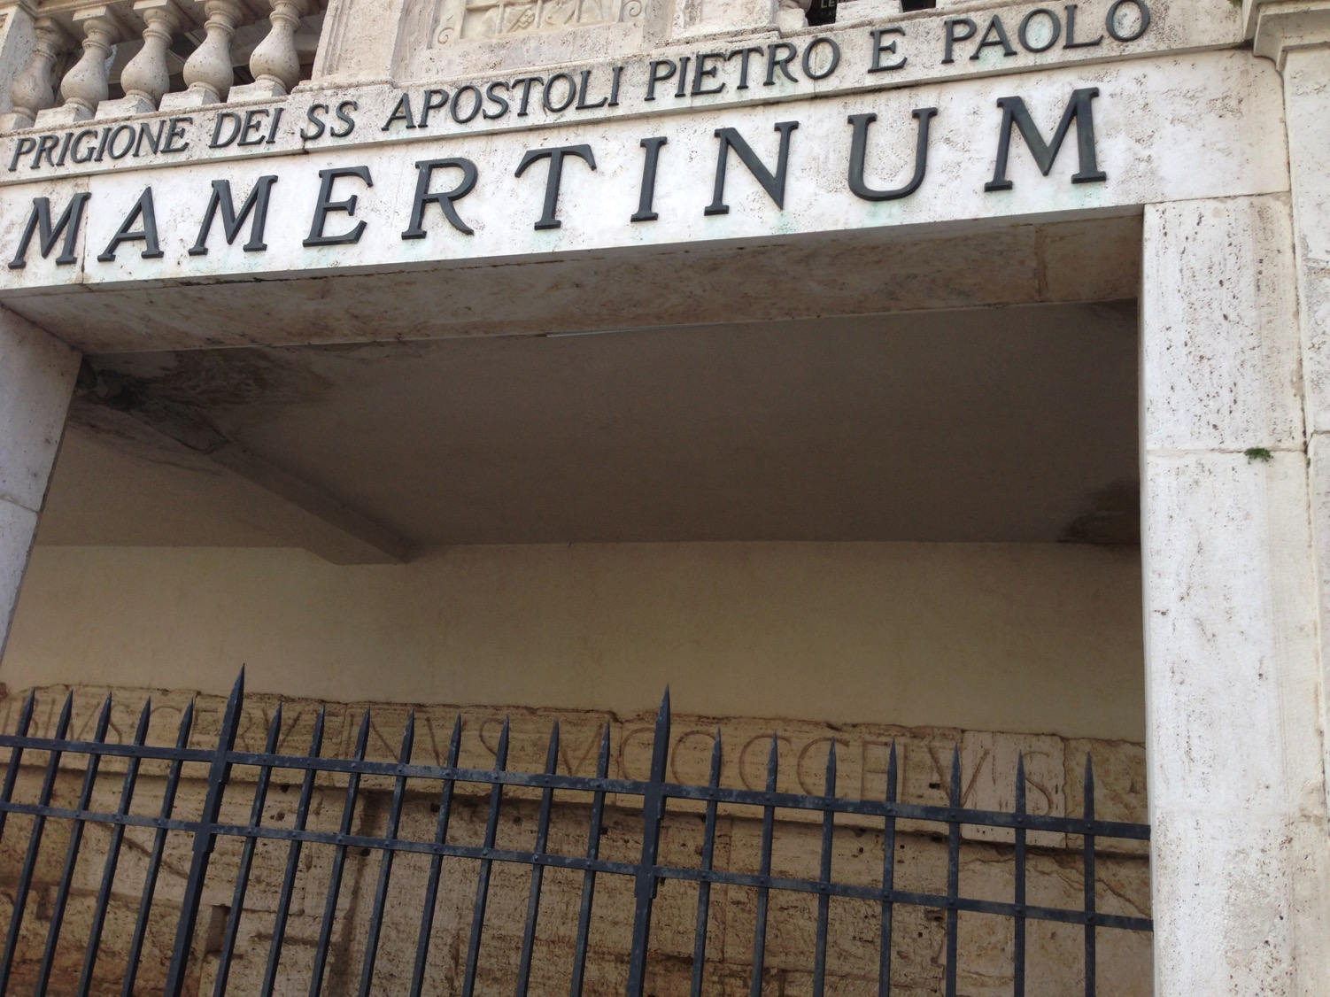
سجن الرسل بطرس و بولس في مامرتين
Notes:
These two most prominent apostles, interestingly, were imprisoned in the same cell but three years apart.

Slide 36
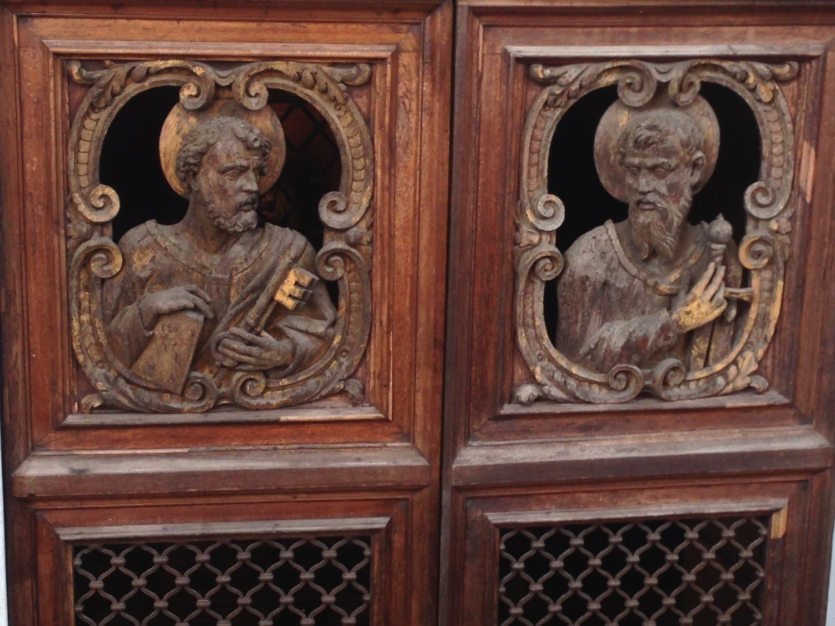
أبواب مامرتين تصور بطرس و بولس
Notes:
Both went through doors like this (AD 64 for Peter, AD 67 for Paul).

Slide 37
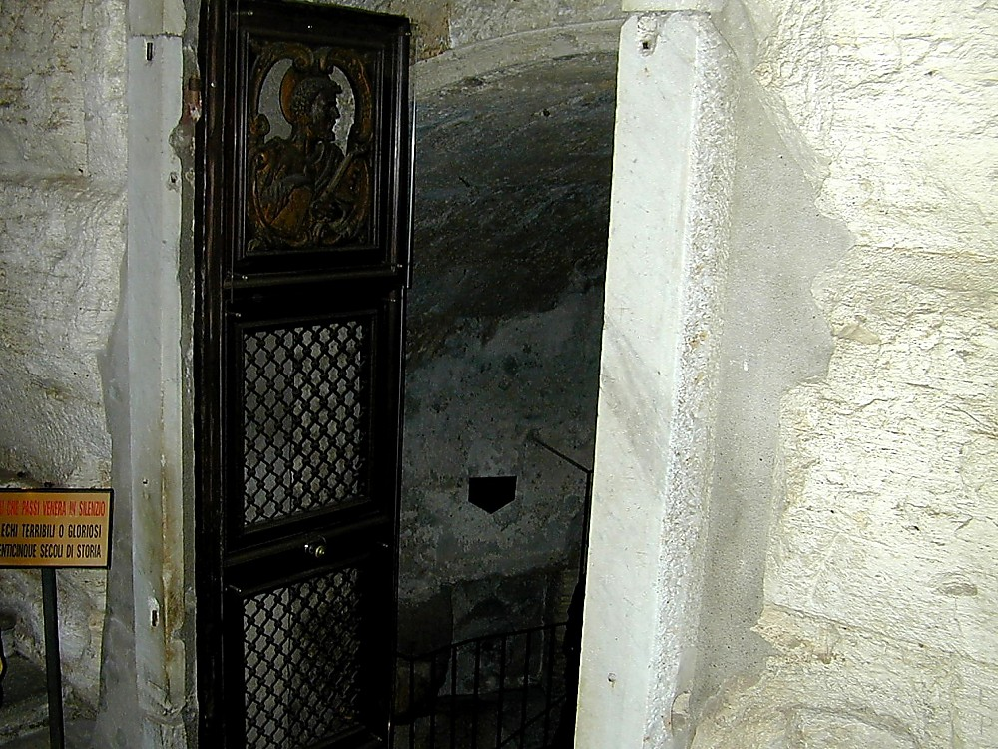
مدخل سجن مارمرتين
Notes:
It is a simple building of stone and iron.

Slide 38
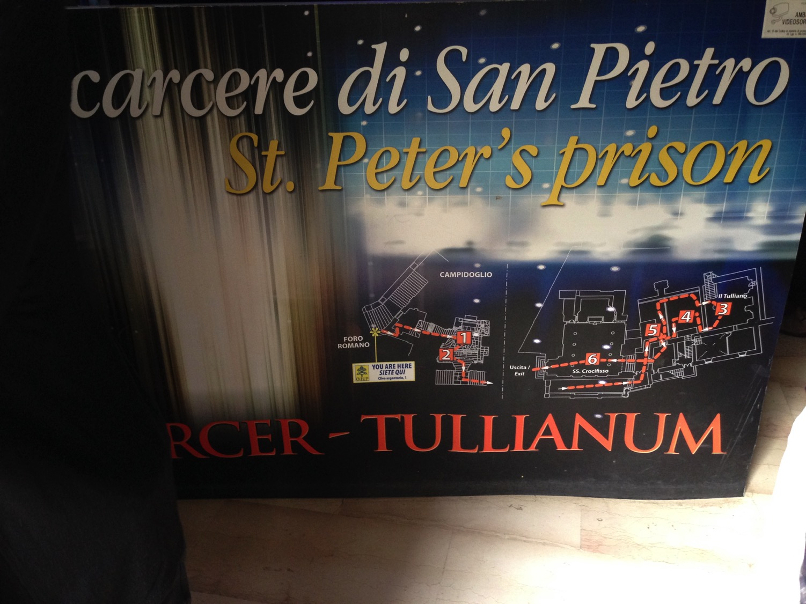
جولة مامرتين
Notes:
Given Peter’s stature as supposedly the first Pope there in Rome, he is given priority over Paul.

Slide 39
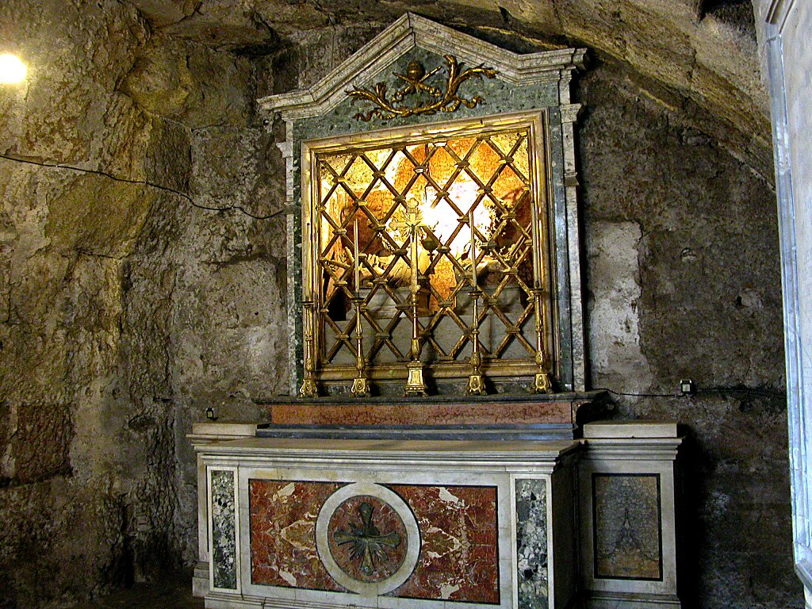
غرفة مامرتين العليا تماثيل نصفية لبطرس وبولس
Notes:
At the ground level is an altar to these great apostles. Yet they had little time at this level, for they were lowered into a hole in the floor and kep below.

Slide 40
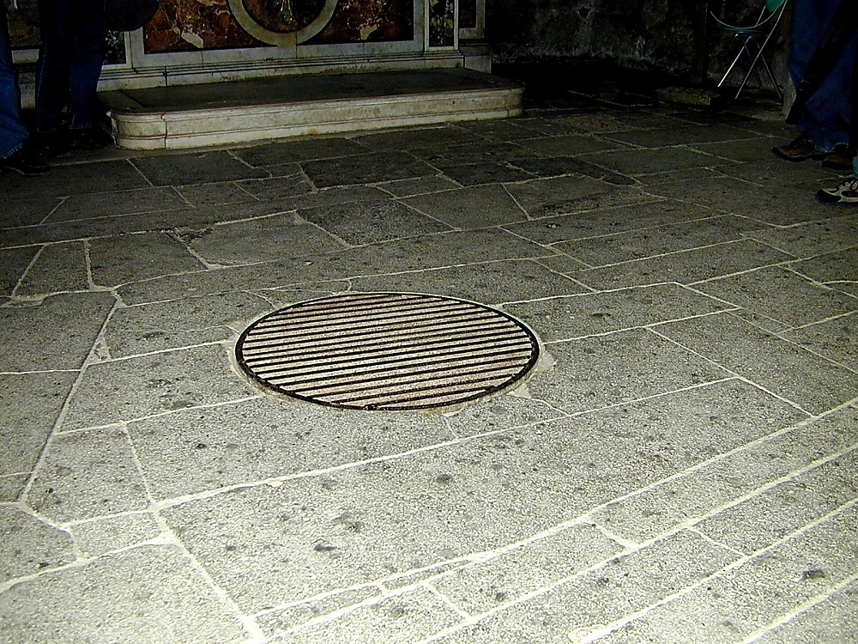
تم إنزال السجناء من خلال فتحة التفتيش إلى الخزان السابق أدناه
Notes:
The Carcer was the only prison in ancient Rome. It had two sections, an upper and a lower; the upper was known as the "Carcer" proper, while the lower (originally thought to have been a cistern) was known as the "Tullianum." Those prisoners that entered the Tullianum from the Carcer were lowered through a hole in the Carcer's floor. The name "Tullianum" is probably derived from the Latin word for a spring of water, and incidentally, this section of the prison does, in fact, house a well. According to tradition, the Apostle Peter caused the well-water to spring up so that he might baptize his jailors, St. Processus and St. Martinianus. It is debated whether Peter was actually incarcerated here. —Todd Bolen, BiblePlaces.com

Slide 41
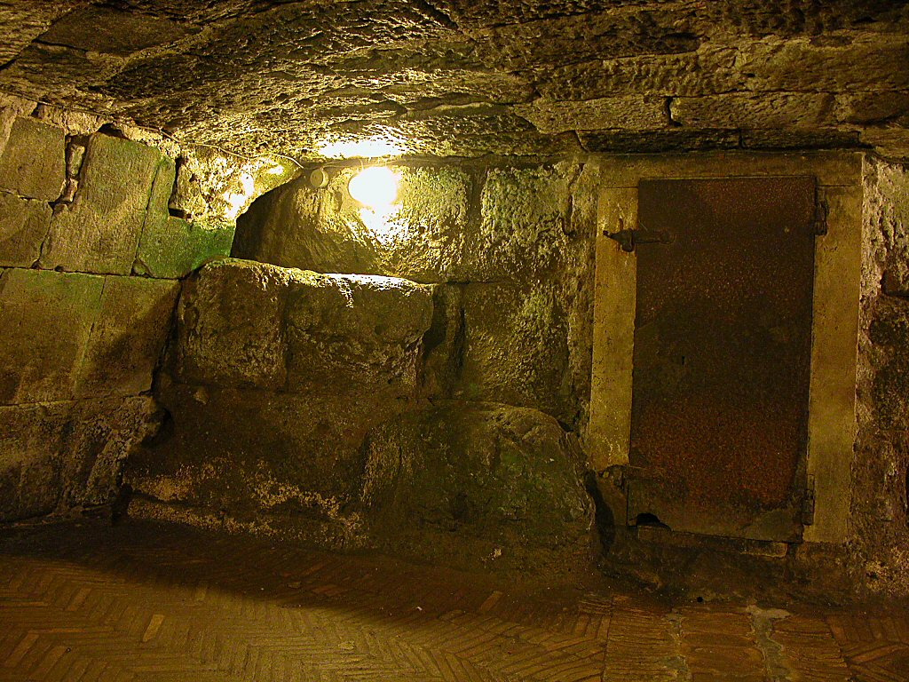
Mamertine Prison writing area and door
منطقة الكتابة و باب سجن مامرتين
Notes:
The state rarely incarcerated common criminals but kept the Mamertine Prison for political prisoners doomed for execution by being thrown off the Tarpeian Rock. Enemies of the State, such as Jugurtha and Vercingetorix, were often strangled in the Tullianum. Sallust, a Roman writer in 40 B.C., described the Tullianum as "about twelve feet deep, closed all round by strong walls and a stone vault. Its aspect is repugnant and fearsome from its neglect, darkness, and stench."
—Todd Bolen, BiblePlaces.com

Slide 42
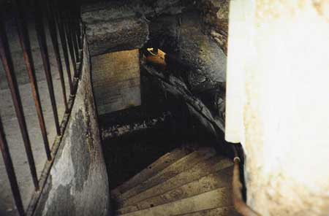
أسفل الدرج
Notes:
Now steps have been added so people like me and you can descend into the lower level that Paul had to enter via the hole.

Slide 43
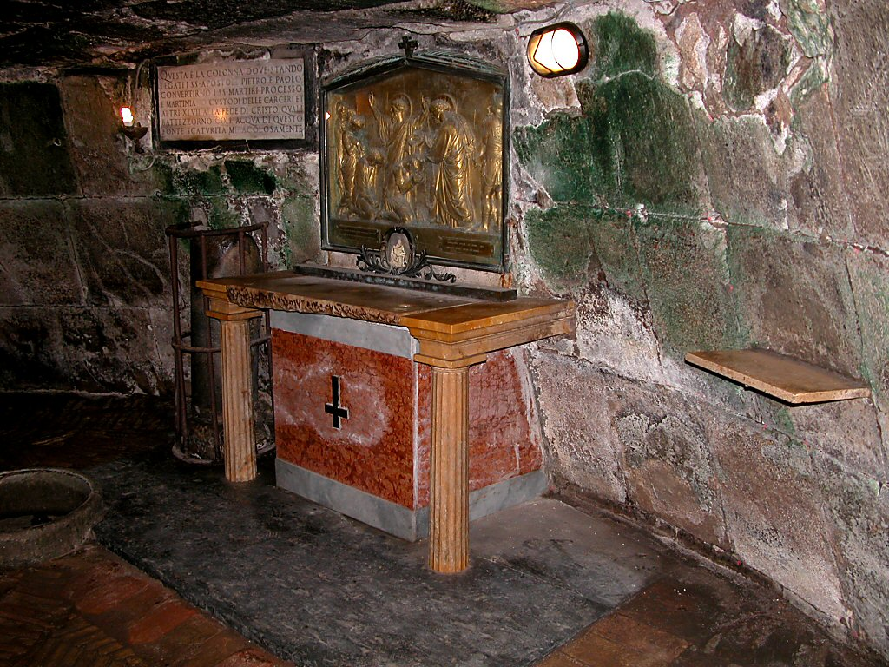
زنزانة بطرس (64 م) وبولس (67-68 م) أدناه
Notes:
When told that he would die by crucifixion, Peter felt he was not worthy to die by the same means as Jesus. He requested to be crucified upside down, and the Romans obliged. The altar recalls this with an upside down cross.

Slide 44
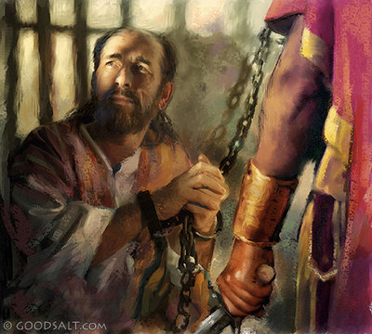
البيان الموجز
2 تيموثاوس
237
المثابرة ضد الإرتداد رغم المشقة ، بالوعظ بالكلمة بكل أمانة.

Slide 45
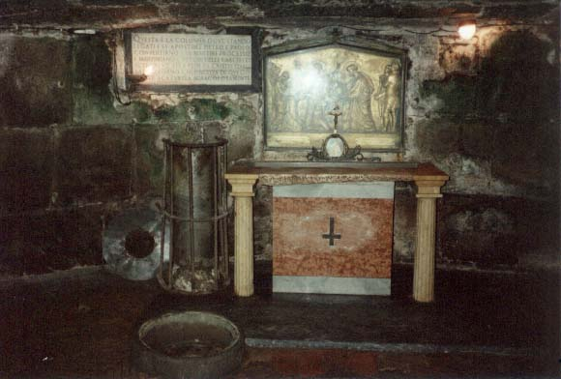
مواضيع رئيسية
2 تيموثاوس
1. الأمانة
2. الإرتداد
3. كلمة الله الموحى بها

Slide 46
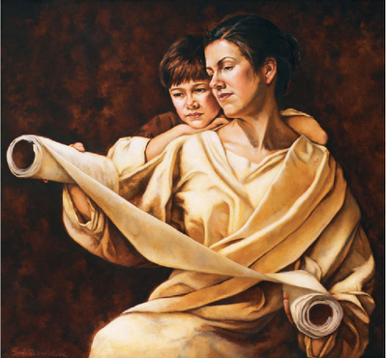
الموضوع الرئيسي 1 : الأمانة
2 تيموثاوس
أمثلة عن الأمانة
أ. تعلم من أمه أفنيكي و جدته لوئيس (1: 3-7)
تعلم تيموثاوس في ​​منزله المختلط الوالدين ، حيث كانت النساء في حياته قدوة للإخلاص في التعاملات اليومية.

Slide 47

الموضوع الرئيسي 1 : الأمانة
2 تيموثاوس
ب. تعلم من بولس (1: 8-14)
بقي بولس أميناً في الأوقات الصعبة لأنه آمن ووثق بالله بأن يحفظه حتى النهاية
(1: 11-12)

Slide 48
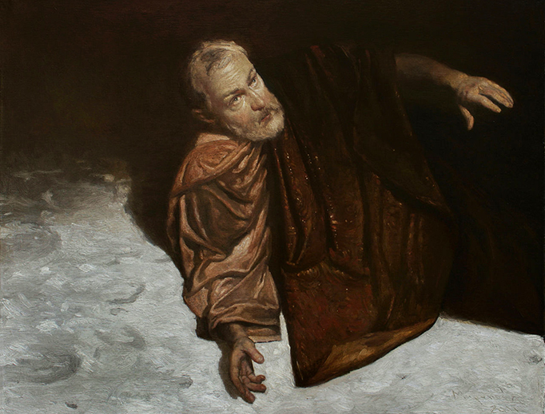
الموضوع الرئيسي 1 : الأمانة
2 تيموثاوس
  ت. تعلم من أنيسيفورس (1: 15-18)
  كان أنيسيفورس غير خجل ليعرف بأنه صديق بولس عندما كان سجيناً . لقد بحث عن بولس بإخلاص ووجده

Slide 49
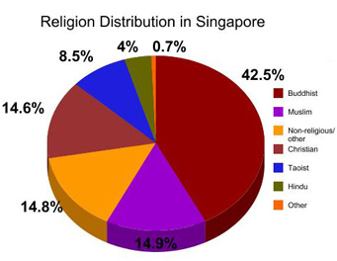
التوزيع الديني في سنغافورة
4%
7ر0%
5ر8%
5ر42%
البوذيون
البوذيون
المسلمون
6ر14%
المسيحيون
اللادينيون
المسيحيون
اللادينيون
الطاويون
الهندوس
8ر14%
أخرى
المسلمون
9ر14%
ستريتس تايمز 14 يناير 2013
Notes:
Singapore may have seen church growth, but it is only a microcosm of the world as a whole. Even here, the increase of so-called "free thinkers" who claim no religion continues to increase. Christians are afraid to share their faith in the marketplace and are going underground in many ways, fearing they might lose their job.
http://therealsingapore.com/content/op-ed-straits-times-different-under-god

Slide 50
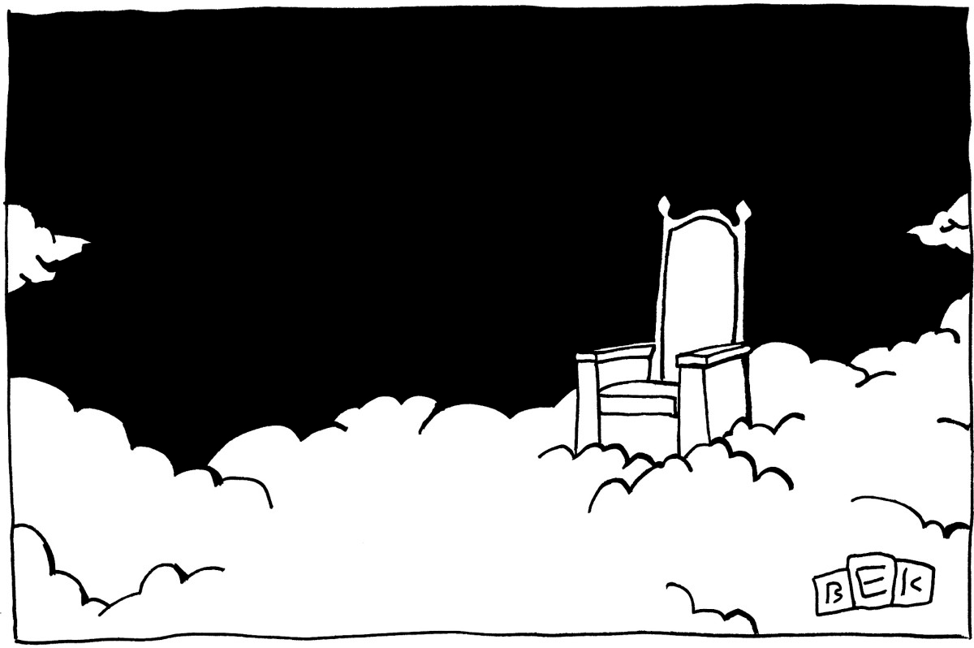
لا يوجد إله
كيف يجب أن تتعامل مع العلمانية؟
2 تيموثاوس 3
يعطينا طريقتين
Notes:
How should you deal with secularism? How should believers respond to the increasing godlessness of our age?

Slide 51
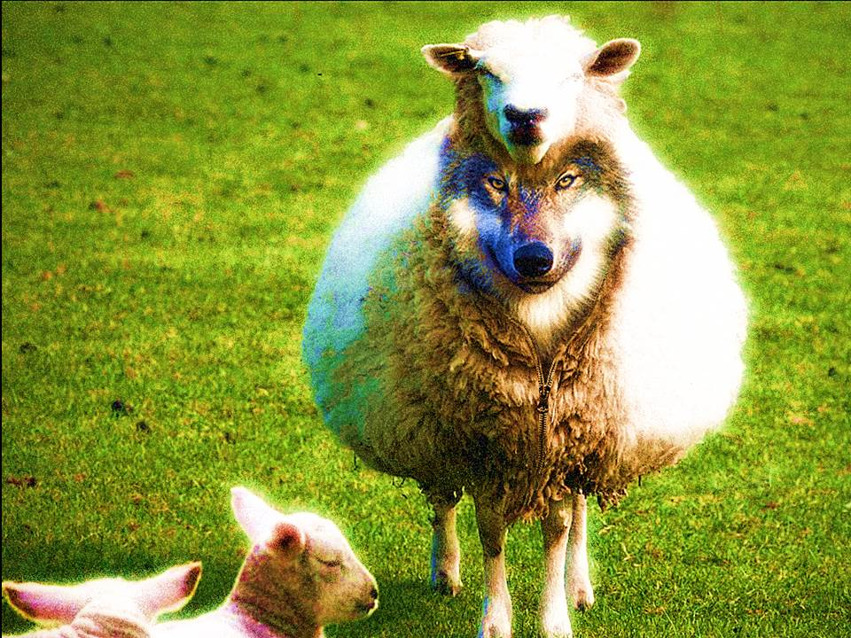
تجنب
المعلمين
الكذبة
(3: 1-9)
Notes:
How else can we deal with heretics besides avoiding them? What are those efforts that will last? Paul says, "But you…" in verse 10 to give us what to do instead of following godless teachers. We can deal with secularism when we…

Slide 52
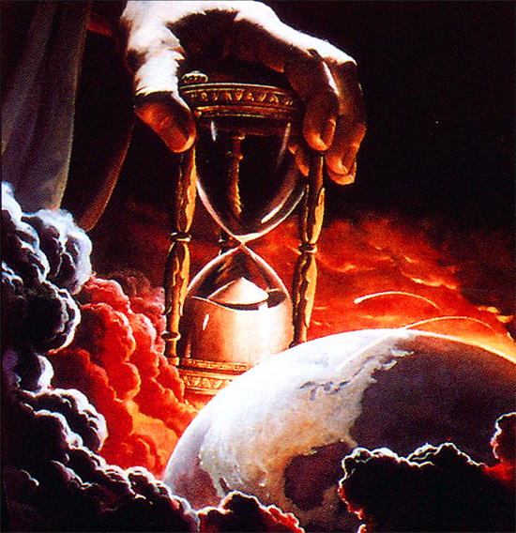
¹وَلكِنِ اعْلَمْ هذَا
أَنَّهُ فِي
الأَيَّامِ الأَخِيرَةِ
سَتَأْتِي
أَزْمِنَةٌ صَعْبَةٌ
(3: 1)
Notes:
We are promised difficulty (3:1).
Paul was experiencing great trials when he wrote this.

Slide 53
الموضوع الرئيسي الثاني: الإرتداد
2 تيموثاوس
- سجل بولس 19 صفة للايام الأخيرة والتي
ترينا علامات العقيدة الخاطئة (3: 1-5)
- تكلم بولس عن وقت عندما يرفض الناس
العقيدة السليمة (4: 3-4)
- نصح بولس تيموثاوس أن يبقى بعيداً عن
هؤلاء الناس (3: 5-8)
Notes:
Many were falling away just before Paul's death, he carefully chose his words in perhaps his last statements to Timothy in order to assure that Timothy himself would remain true to the faith until death. Paul did this end by exhorting him to persevere in present hardships with godly character (2 Tim. 1–2). This included several examples of faithfulness (1:3-18) as well as what perseverance looks like in his list of the characteristics of a faithful minister (2:1-26).

Slide 54
٢ تيموثاوس ٣ : ١
ولكن اعلم هذا أنه في الأيام الأخيرة ستأتي أزمنة صعبة
Notes:
When did the "last days" begin and are we in the "last days" today?
This period began in the first century. Paul noted in 1 Timothy 4:1 that apostasy would characterize the "last days," and Jude 18 applies this his own time in the first century.
These "last days" then continue up to the present time and until Christ's return.

Slide 55
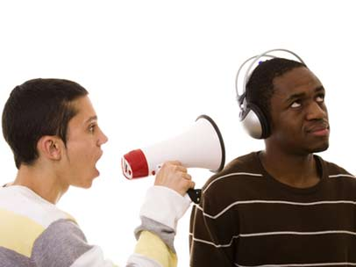
ستكون الحياة صعبة لأن الأشرار يخدعون الآخرين (3: 2-5أ)

Slide 56
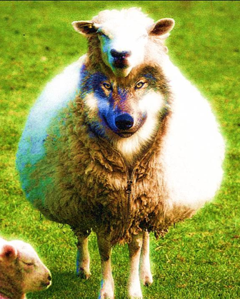
19 صفة للمرتدين (3: 1-5)
2 تيموثاوس
محبين لأنفسهم
محبين للمال
متعظمين
مستكبرين
مجدفين
غير طائعين لوالديهم
غير شاكرين
دنسين
بلا حنو
بلا رضى
ثالبين
عديمي النزاهة
شرسين
غير محبين للصلاح
خائنين
مقتحمين
متصلفين
محبين للذات دون محبة الله
لهم صورة التّقوى ولكنهم منكرون قوتها
Notes:
Paul lists 19 characteristics of secular people who actually do not appear so secular, as they have a religious nature about them. It is a very sobering list.
Verses 2-5 give 19 sad traits of people in general.
This is followed by the characteristics of religious leaders in verses 6-9.
Beginning in verses 6-7, "Paul focused on the specific situation in Ephesus. It was from the increasingly large group in society who displayed the preceding characteristics that the false teachers had emerged to plague the church" (BKC).

Slide 57
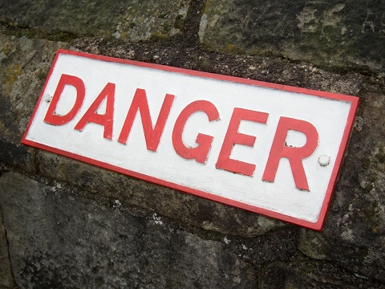
ماذا يجب أن نفعل؟
خطر
Notes:
What should we do with such people? Should we confront them? Should we debate them? No. Paul says to…

Slide 58

تجنب القادة الكذبة
فأعرض عن هؤلاء
(2 تي 3: 5ب فاندايك)
فابتعد عن هؤلاء
(2 تي 3: 5ب المبسطة)
Notes:
The advice to us today is often to engage with false teachers. However, Paul's meaning here is to "purposely to avoid associating with someone, turn away from, avoid" (BDAG).

Slide 59

تجنب القادة الملحدين
Notes:
But how could Timothy avoid godless people when they were all around him (5b)? "No doubt Paul had in mind here Timothy's official associations, since he had already instructed Timothy to be kind to everyone (cf. 2 Tim. 2:24)" (BKC)
(But why should we avoid associations with such heretical leaders? It is because…)

Slide 60
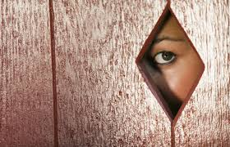
6 فإنه من هؤلاء هم الذين يدخلون البيوت، ويسبون نسيات محملات خطايا، منساقات بشهوات مختلفة.
7 يتعلمن في كل حين، ولا يستطعن أن يقبلن إلى معرفة الحق أبداً.
(2 تي 3: 6-7)
Notes:
Heretics are doomed despite their popularity (3:6-9).
Gullible women loved the latest heresy (3:6-7).
(Why is it a waste of time listening to heretics?)

Slide 61
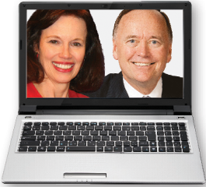
8 وكما قاوم ينيس ويمبريس موسى، كذلك هؤلاء أيضا يقاومون الحق. أناس فاسدة أذهانهم ومن جهة الإيمان مرفوضون 9 لكنهم لا يتقدمون أكثر، لأن حمقهم سيكون واضحاً للجميع، كما كان حمق ذينك أيضاً.
(3: 8-9)
Notes:
Godless teachers are doomed due to their depraved minds that reject truth (3:8-9).
"The reference to Jannes and Jambres and their opposition to Moses draws not on the Old Testament but on a widespread Jewish legend about two of Pharaoh's magicians who competed against Moses and lost (cf. Ex. 7:11; 9:11). The comparison between the false teachers and the Egyptians, and implicitly therefore Timothy and Moses, must have encouraged the young minister" (BKC).
————————
Common Core State Standards in Mathematics, Grades 3–8
In this timely and practical course, Dr. Kanold and Dr. Briars explain both the whys and the how-tos for implementing the CCSS
http://www.solution-tree.com/authors/tim-kanold/ccss-math-3-8-online-course.html

Slide 62

شكراً لك على عدم تشويش عقلك
يتم الكشف عن قيمنا من خلال ما نعتبره قمامة. يريد الله منا اليوم أن نستثمر طاقاتنا في جهود تدوم.

Slide 63
تجنب
المعلمين
الكذبة
(3: 1-9)
Notes:
How else can we deal with heretics besides avoiding them? What are those efforts that will last? Paul says, "But you…" in verse 10 to give us what to do instead of following godless teachers. We can deal with secularism when we…

Slide 64
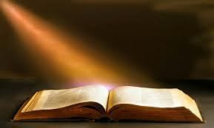
اقبل الحق (3: 10-17)
Notes:
Feed yourself reality from God's servants and God's Word.

Slide 65

أ. اتبع خدام الله (3: 10-13)

Slide 66
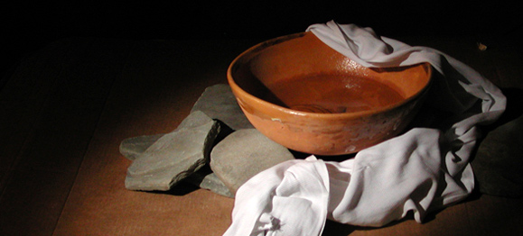
¹⁰وَأَمَّا أَنْتَ فَقَدْ تَبِعْتَ تَعْلِيمِي، وَسِيرَتِي، وَقَصْدِي، وَإِيمَانِي، وَأَنَاتِي، وَمَحَبَّتِي، وَصَبْرِي، ¹¹وَاضْطِهَادَاتِي، وَآلاَمِي، مِثْلَ مَا أَصَابَنِي فِي أَنْطَاكِيَةَ وَإِيقُونِيَّةَ وَلِسْتِرَةَ. أَيَّةَ اضْطِهَادَاتٍ احْتَمَلْتُ! وَمِنَ الْجَمِيعِ أَنْقَذَنِي الرَّبُّ. (3 : 10-11)
Notes:
Follow Paul's example in suffering (3:10-11).
We often say, "Don't follow me. Follow Christ." That sounds humble, but people need to see contemporary examples of Jesus.
Paul said to follow Christ, but he also encouraged his readers to follow him. "Follow me, as I follow Christ" (Eph. 5:1)

Slide 67
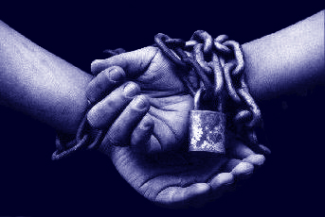
توقع أن تتألم بسبب التقوى كما حدث مع بولس (2 تيموثاوس 3: 12)

Slide 68
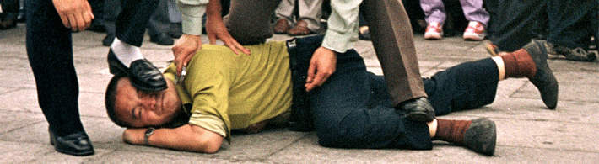
¹²وَجَمِيعُ الَّذِينَ يُرِيدُونَ أَنْ يَعِيشُوا بِالتَّقْوَى فِي الْمَسِيحِ يَسُوعَ يُضْطَهَدُونَ. ¹³وَلكِنَّ النَّاسَ الأَشْرَارَ الْمُزَوِّرِينَ سَيَتَقَدَّمُونَ إِلَى أَرْدَأَ، مُضِلِّينَ وَمُضَلِّينَ. (2 تي 3: 12-13)

Slide 69
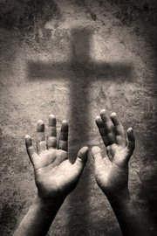
¹²وَجَمِيعُ الَّذِينَ يُرِيدُونَ أَنْ يَعِيشُوا بِالتَّقْوَى فِي الْمَسِيحِ يَسُوعَ يُضْطَهَدُونَ (2 تي 3: 12)
Notes:
This verse seems so incredible to us that we strain at a gnat to explain it away. "Surely that look they gave me is a form of persecution!" we rationalize.
More likely, we are fooling ourselves into thinking that we are really living a godly life.

Slide 70
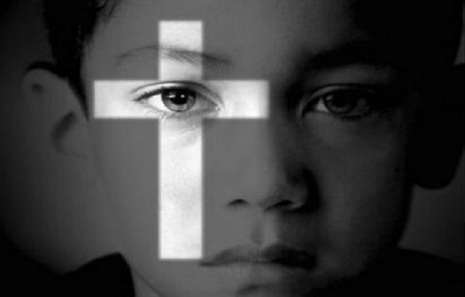
اضطهاد الأطفال
Notes:
We need not look too far to find examples of the godly facing persecution. In fact, in 2014 we heard of examples of even Christian children in Iraq who refused to deny Christ and were literally crucified and beheaded as a result.
Perhaps it is time to realize that this verse really isn't as perplexing as it seems. More perplexing is our ability to explain it away.

Slide 71

٢ تيموثاوس ٣ : ١٣
وَلَكِنَّ النَّاسَ الأَشْرَارَ الْمُزَوِّرِينَ سَيَتَقَدَّمُونَ إِلَى أَرْدَأَ، مُضِلِّينَ وَمُضَلِّينَ.
Notes:
Here is why we need godly examples: the ungodly ones are sure to increase.
The very deceptive part is that when a person is deceived, he doesn't even know it. That is why he is deceived! Are you?

Slide 72
كيف نقبل الحق بدلاً من الكذب ؟
الحق
الأكاذيب
Notes:
How can we accept truth instead of lies?

Slide 73
أ. اتبع خدام الله (3: 10-13)

Slide 74
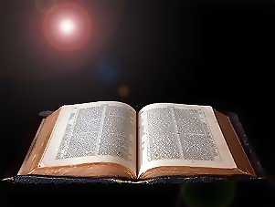
ب. اتبع كلمة الله (3: 14-17)

Slide 75
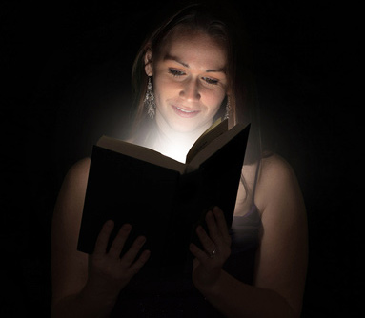
٢ تيموثاوس ٣ : ١٤-١٥
١٤ وَأَمَّا أَنْتَ فَاثْبُتْ عَلَى مَا تَعَلَّمْتَ وَأَيْقَنْتَ، عَارِفاً مِمَّنْ تَعَلَّمْتَ. ١٥ وَأَنَّكَ مُنْذُ الطُّفُولِيَّةِ تَعْرِفُ الْكُتُبَ الْمُقَدَّسَةَ، الْقَادِرَةَ أَنْ تُحَكِّمَكَ لِلْخَلاَصِ …
Notes:
Stay true to God's truth that you learned (3:14-15a).
We must remain, abide, or stay (BDAG) faithful to the truth (3:14a).
Paul gives two reasons we must keep the truth (3:14b-15a).
(1) Our teachers are trustworthy (3:14a).
Timothy first learned from his believing mother and grandmother (cf. 2 Tim. 1:5; Acts 16:1).
Paul later referred to him as his "son" in the faith (1 Tim. 1:2; 2 Tim. 1:2).
(But how can teachers be trustworthy?)
(2) They are trustworthy because they taught us the Bible (3:15a).
Survey any Christian gathering and you will find that most trusted Christ before age 18.
We cannot overemphasize how vital it is to train children in God's Word.
(But why is teaching the Bible so important?)

Slide 76

بركات كلمة الله (3: 15ب – 17)
Notes:
Why is teaching the Bible so important?
Because when you continue in God's Word it blesses you in many ways (3:15b-17)

Slide 77

٢ تيموثاوس ٣ : ١٥
الْكُتُبَ الْمُقَدَّسَةَ، الْقَادِرَةَ أَنْ تُحَكِّمَكَ لِلْخَلاَصِ، بِالإِيمَانِ الَّذِي فِي الْمَسِيحِ يَسُوعَ
Notes:
Scripture gives us wisdom to accept Christ (3:15b).
True wisdom focuses on what's most important.
Since the Scripture is genuine wisdom, it helps us trust in the only source of salvation—Christ Jesus.

Slide 78

٢ تيموثاوس ٣ : ١٦
كُلُّ الْكِتَابِ هُوَ مُوحىً بِهِ مِنَ اللهِ
Notes:
Scripture comes from God's own "mouth" (3:16a).

Slide 79

كل الكتاب هو موحى به
(2 تيموثاوس 3: 16أ)
Notes:
The Greek word for "inspiration" literally means "God-breathed."

Slide 80

كل الكتاب هو موحى به
(2 تيموثاوس 3: 16أ)
Notes:
True, God used people, but his Spirit spoke through them so the Scriptures are without error.

Slide 81

لماذا كلمة الله مفعمة بالحيوية جداً؟
١٦ كُلُّ الْكِتَابِ هُوَ مُوحىً بِهِ مِنَ اللهِ، وَنَافِعٌ لِلتَّعْلِيمِ وَالتَّوْبِيخِ، لِلتَّقْوِيمِ وَالتَّأْدِيبِ الَّذِي فِي الْبِرِّ، ١٧ لِكَيْ يَكُونَ إِنْسَانُ اللهِ كَامِلاً، مُتَأَهِّباً لِكُلِّ عَمَلٍ صَالِحٍ.
٢ تيموثاوس ٣ : ١٦-١٧

Slide 82

أربع نتائج لكلمة الله
التقويم
التوبيخ
التأديب
(في البر)
التعليم
2 تيموثاوس 3: 16-17
Notes:
If you read sequentially through the Bible, you will have the divine balance in these four areas:
Teaching tells people how to walk God's road
Rebuking tells them when they get off the path
Correcting shows how to get back to the right way
Training in righteousness is the result of the cycle of teaching, rebuking and correcting over and over.

Slide 83
الموضوع الرئيسي الثالث: الكتاب المقدس
2 تيموثاوس
نظرة بولس للكتاب المقدس
  أ. وحي / أنفاس الله (3: 16، 2 بط 1: 21)
  ب. نافعة (3: 17)
  - التعليم
  التوبيخ
  التقويم
  التأديب الذي في البر
الغرض من ذلك هو تجهيزنا لنكون كاملين وقادرين وأكفاء... لتلبية جميع المطالب ضد التعاليم الكاذبة والقيام بالأعمال الصالحة.
Notes:
Scripture equips us to do every good work (3:17).
To do a job well, we need the right tools. The Bible doesn't just make us "adequate" in a limited sense. The Greek word here is "fully qualified" or "complete, capable, proficient in the sense of being able to meet all demands" (BDAG).
The result of all these benefits is that we have the tools to do any good deed.

Slide 84

كيف تكون
علمانياً؟
Notes:
So we live in a world that is increasingly secular.

Slide 85

كل الديانات متساوية
Notes:
We are told lies like all the world's religions are the same.

Slide 86

كل الديانات متساوية
Notes:
Many seek to combine them all as if there is no real truth.

Slide 87
ليس هناك إله
كيف يجب أن تتعامل مع العلمانية؟
Notes:
So how should you deal with this kind of secularism—a kind that often portrays itself as having a form of godliness without God?

Slide 88

الفكرة الرئيسية
استبدل الأكاذيب بالحق
Notes:
Don't get sucked into secular thinking—but instead rely upon godly values, truth.
But how can you learn truth instead of lies?

Slide 89
تجنب
المعلمين
الكذبة
(3: 1-9)
Notes:
How else can we deal with heretics besides avoiding them? What are those efforts that will last? Paul says, "But you…" in verse 10 to give us what to do instead of following godless teachers. We can deal with secularism when we…

Slide 90
اقبل الحق (3: 10-17)
Notes:
Feed yourself reality from God's servants and God's Word.

Slide 91

هل ستسير
مع يسوع
عشر سنوات
من الآن ؟
ماذا يجب
أن تفعل الآن
لتتأكد أنك
ستكون أميناً حينها ؟

Slide 92


Garbage in, Garbage out
قمامة
داخلة
قمامة
خارجة
كل شيء يدخل الذهن يؤثر على كيفية تفكيرنا وسلوكنا
لا تدع القمامة تدخل ذهنك
Notes:
Watch your input—your reading, news, friends, movies, TV, and especially the Internet.
We often teach this to children—and rightly so.

Slide 93

Garbage in, Garbage out
Notes:
But GIGO applies to adults too.

Slide 94

هل تبني القراءة و الأخبار و الأصدقاء و الأفلام و التلفاز و الإنترنت خصوصاً إيمانك أم تهدمه ؟

Slide 95



ضاعف نفسك في أشخاص أمناء
²وَمَا سَمِعْتَهُ مِنِّي بِشُهُودٍ كَثِيرِينَ، أَوْدِعْهُ أُنَاسًا أُمَنَاءَ، يَكُونُونَ أَكْفَاءً أَنْ يُعَلِّمُوا آخَرِينَ أَيْضًا.
(2 تي 2: 2)
التلمذة
بولس
تيموثاوس
رجال أكفاء
آخرين
Notes:
Get mentored by godly people (2 Tim. 2:2).

Slide 96

مستويات
التلمذة
مشجع (بولس)
نظير
نظير
(نيموثاوس)
متشجع (آخرين)
Notes:
Each of us should be like Timothy to learn from someone more mature than us, and also be a "Paul" to someone less mature to help that person grow in Christ.

Slide 97

مجموعات
الحياة
المتغيرة
التعهد : تقابل لمدة ساعة أسبوعياً مع شخص أو شخصين آخرين من نفس الجنس لتقديم المحاسبية في ثلاث نقاط :
1. اعترف بخطية في حوالي 10 أسئلة
2. اقرأ 3 اصحاحات من الكتاب المقدس يومياً
3. صلي من أجل الأصدقاء الضالين
شركاء التضاعف في الكنيسة ––www.CMAResources.org
Notes:
How can you mentor and get mentored? Life Transformation Groups are 2-3 people meeting weekly for accountability.
An LTG has 2-3 persons committed to growing spiritually. They meet in a home, restaurant, church, business, or wherever they can have a 60-minute accountability session each week.

Slide 98


مجموعات
الحياة
المتغيرة
Church Multiplication Associates––www.CMAResources.org
Notes:
No LTG should be larger than 3 people. Once a member invites a 4th person and it is shown that this 4th person will be committed to the LTG concept, the group of 4 multiplies into 2 groups of 2 persons. The additional members can be believers or unbelievers, as long as they are committed to confession, Bible reading, and prayer.

Slide 99




مجموعات
الحياة
المتغيرة
Church Multiplication Associates––www.CMAResources.org
Notes:
Ideally, the church is then composed of many LTG groups at different stages, growing to multiply more groups so that accountability remains intact in a small group for each person.

Slide 100



DTS Online
Notes:
Dallas Theological Seminary sees learning as a lifelong process, so the seminary offers free online courses. Sign up for one of them this week!

Slide 101

التطبيق
2 تيموثاوس
237
هل هناك شيء أقوى ضد الهرطقة من كلمة الله – الأساليب، والمنطق، وتجاهل التعاليم الكاذبة، وما إلى ذلك؟
مع أن التعليم المناسب ليس هو الشيء الوحيد الذي نحتاجه، لكنه الشيء الأكثر أهمية.

Slide 102
Black

Slide 103


الكرازة • BibleStudyDownloads.org
احصل علي هذا العرض مجانا!
Notes:
EV Evangelism in Arabic

